Slide 1



HEAP SORT
EXPLANATION
Heap Sort is a comparison-based sorting algorithm that uses a binary heap data structure to sort an array. It works by first building a max-heap from the array and then repeatedly extracting the maximum element (at the root) and moving it to the end of the array.
The array is effectively divided into two parts: the sorted part at the end and the unsorted part at the beginning. The sorted part grows as elements are extracted from the heap.

Slide 2
HEAP SORT
WHERE IT WORKS
Heap Sort can be used to sort an array of any data type for which a comparison operation is defined. It's commonly used in practice for sorting large datasets because of its time complexity and lack of extra space requirements.

Slide 3
HEAP SORT
IMPORTANT TERMINOLOGY
Heap: A binary tree-based data structure that satisfies the heap property. In Heap Sort, we typically use a binary heap. It's either a max-heap or min-heap, where the root node contains the maximum or minimum element, respectively.

Slide 4
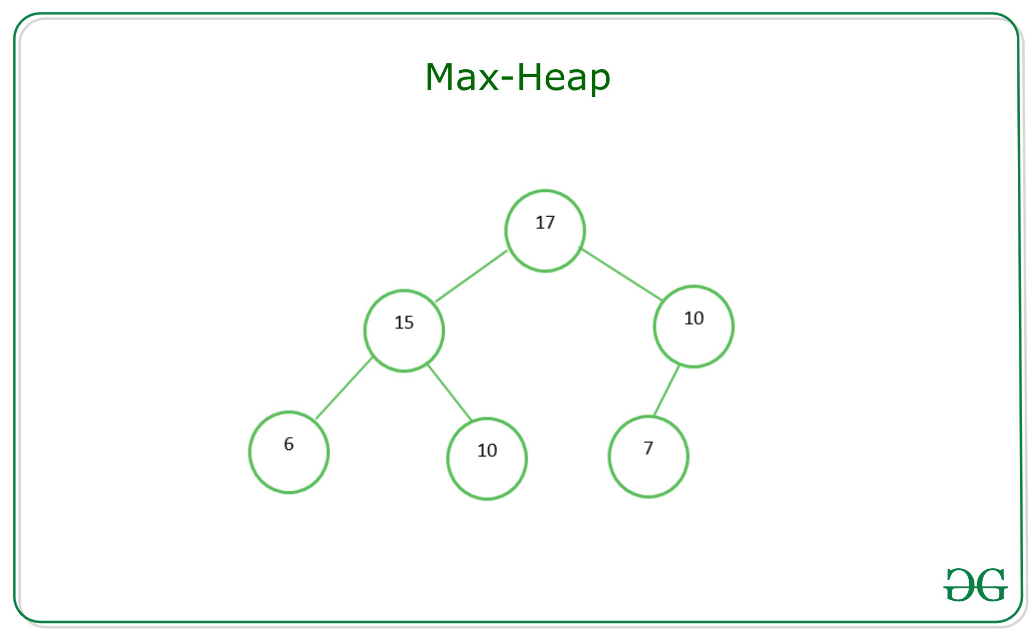
HEAP SORT
IMPORTANT TERMINOLOGY
Max-Heap: A type of binary heap where the value of each node is greater than or equal to the values of its children. The maximum element is always at the root.

Slide 5
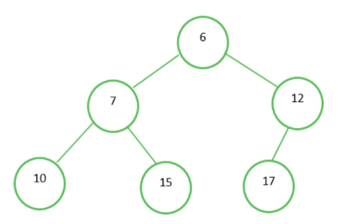
HEAP SORT
IMPORTANT TERMINOLOGY
Min-Heap: A type of binary heap where the value of each node is less than or equal to the values of its children. The minimum element is always at the root.

Slide 6
HEAP SORT
IMPORTANT TERMINOLOGY
Heapify: A process that ensures that a given binary tree satisfies the heap property. This involves adjusting the elements of the tree to ensure that the parent node is larger (in a max-heap) or smaller (in a min-heap) than its children.
Root: The topmost node in a heap, which contains the maximum (in a max-heap) or minimum (in a min-heap) value in the heap.

Slide 7
HEAP SORT
IMPORTANT TERMINOLOGY
Parent Node: A node in a binary heap that has child nodes. The parent node's value is greater (in a max-heap) or smaller (in a min-heap) than its child nodes.
Child Node: Nodes in a binary heap that are connected to a parent node. In a max-heap, child nodes have values less than or equal to the parent node, and in a min-heap, they have values greater than or equal to the parent node.
Leaf Nodes: Nodes in a binary heap that have no children. They are the nodes at the bottom of the heap.

Slide 8
HEAP SORT
IMPORTANT TERMINOLOGY
30 (Root)
/ \
20 15 (Parent Nodes)
/ \ / \
10 12 7 9 (Child Nodes)

Slide 9
HEAP SORT
ALGORITHM
1. Build a max-heap from the array.
2. Extract the maximum element (root) and move it to the end of the array.
3. Reduce the size of the heap (effectively excluding the last element, which is now sorted).
4. Restore the max-heap property by calling `heapify` on the root.
5. Repeat steps 2-4 until the heap is empty (i.e., all elements are sorted).

Slide 10
HEAP SORT
PSEUDOCODE
heapSort(arr):
buildMaxHeap(arr)
for i from n-1 down to 1:
swap arr[0] and arr[i]
heapify(arr, i, 0)
buildMaxHeap(arr):
n = arr.length
for i from n/2 - 1 down to 0:
heapify(arr, n, i)
heapify(arr, n, i):
largest = i
left = 2*i + 1
right = 2*i + 2
if left < n and arr[left] > arr[largest]:
largest = left
if right < n and arr[right] > arr[largest]:
largest = right
if largest != i:
swap arr[i] and arr[largest]
heapify(arr, n, largest)

Slide 11
HEAP SORT
EXAMPLE
To sort the elements in the decreasing order, use a min heap
To sort the elements in the increasing order, use a max heap
19
12
16
1
4
7

Slide 12
HEAP SORT
Take out biggest
19
12
16
Move the last element
to the root
1
4
7
Sorted:
Array A
12
16
1
4
7
19

Slide 13
HEAP SORT
7
swap
HEAPIFY()
12
16
1
4
Sorted:
Array A
7
12
16
1
4
19

Slide 14
HEAP SORT
16
12
7
1
4
Sorted:
Array A
16
12
7
1
4
19

Slide 15
HEAP SORT
Take out biggest
16
Move the last element
to the root
12
7
1
4
Sorted:
Array A
12
7
1
4
16
19

Slide 16
HEAP SORT
4
12
7
1
Sorted:
Array A
4
12
7
1
16
19

Slide 17
HEAP SORT
swap
4
HEAPIFY()
12
7
1
Sorted:
Array A
4
12
7
1
16
19

Slide 18
HEAP SORT
12
4
7
1
Sorted:
Array A
12
4
7
1
16
19

Slide 19
HEAP SORT
Take out biggest
12
Move the last
element to the
root
4
7
1
Sorted:
Array A
4
7
1
12
16
19

Slide 20
HEAP SORT
1
swap
4
7
Sorted:
Array A
1
4
7
12
16
19

Slide 21
HEAP SORT
7
4
1
Sorted:
Array A
7
4
1
12
16
19

Slide 22
HEAP SORT
Take out biggest
7
Move the last
element to the
root
4
1
Sorted:
Array A
1
4
7
12
16
19

Slide 23
HEAP SORT
swap
1
HEAPIFY()
4
Sorted:
Array A
4
1
7
12
16
19

Slide 24
HEAP SORT
Take out biggest
Move the last
element to the
root
4
1
Sorted:
Array A
1
4
7
12
16
19

Slide 25
HEAP SORT
Take out biggest
1
Sorted:
Array A
1
4
7
12
16
19

Slide 26
HEAP SORT
public static void main(String args[])
{
int[] arr = new int[n];
Arrays.sort(arr);
System.out.println("\nThe sorted array is: ");
for (int num : arr) System.out.print(num + " ");
}

Slide 27
HEAP SORT
TIME AND SPACE COMPLEXITY
Time Complexity:
Building the initial max-heap takes O(n) time.
The main loop for extracting elements and heapifying takes O(n * log(n)) time.
The overall time complexity is O(n * log(n)).
Space Complexity:
Heap Sort is an in-place sorting algorithm, which means it doesn't require additional memory for sorting.
The space complexity is O(1) since it sorts the input array in place.

Slide 28
INTERVIEW QUESTIONS
4. What is the main advantage of using Heap Sort?
The main advantage of Heap Sort is its ability to provide consistent time complexity of O(n log n) for sorting, making it suitable for large datasets.
It is also an in-place sorting algorithm, which means it does not require additional memory proportional to the size of the input data.
Heap Sort does not depend on the initial order of elements in the array and is not sensitive to input data characteristics.

Slide 29
INTERVIEW QUESTIONS
1. What is Heap Sort, and how does it work?
Answer: Heap Sort is a comparison-based sorting algorithm that works by transforming an array into a max-heap, a specialized binary tree data structure. It repeatedly extracts the maximum element (at the root) and moves it to the end of the sorted portion of the array. This process is repeated until the entire array is sorted. The extracted elements form the sorted output.

Slide 30
INTERVIEW QUESTIONS
2. What are the key operations involved in Heap Sort, and what is their time complexity?
Answer: The key operations in Heap Sort include heapifying the array to build a max-heap and repeatedly extracting the maximum element. The time complexities are as follows:
- Building a max-heap: O(n)
- Extracting the maximum element (heapify): O(log n)
- The overall time complexity of Heap Sort is O(n log n).

Slide 31
INTERVIEW QUESTIONS
3. How does Heap Sort differ from other sorting algorithms like Quick Sort and Merge Sort?
Heap Sort is an in-place sorting algorithm with stable sorting.
Quick Sort has average-case O(n log n) time complexity and can be faster for smaller datasets.
Merge Sort has O(n log n) time complexity but requires additional memory.

Slide 32
INTERVIEW QUESTIONS
5. Can Heap Sort be used to sort data in descending order, and if so, how?
Yes, Heap Sort can sort data in descending order by using a min-heap instead of a max-heap. This involves reversing the comparison conditions during the heapify and swapping operations, ensuring the minimum element is at the root and arranging elements in descending order.

